Slide 1


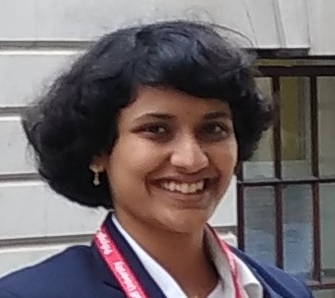
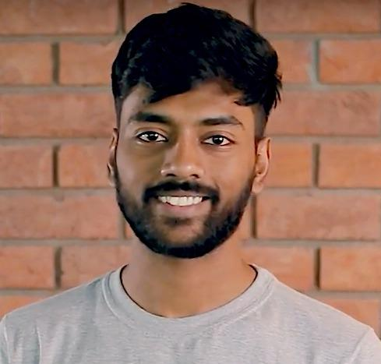



Tutorial on Multi-modal Learning
[Code & models]
A deep-dive into Speaker Separation problem
Sindhu B Hegde
Aditya Agarwal
Bipasha Sen
Rudrabha Mukhopadhyay
Seshadri Mazumder
IIIT Hyderabad
Contact: {sindhu.hegde, aditya.ag, bipasha.sen, radrabha.m}@research.iiit.ac.in

Slide 2
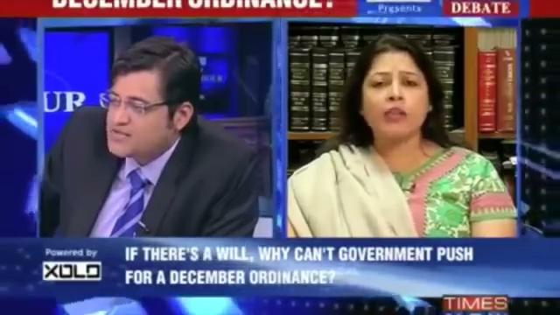
Motivation: Isolating & Enhancing the Target Speaker
Multi-modal learning: Engaging multiple streams/modalities to perform a desired task.
In a cocktail-party like environment, separating a single speaker from other speakers can be an extremely important task.
Example: Understanding the target speaker’s speech in news debates as shown below.
In such challenging situations, using additional information from visual modality along with the audio stream proves to be beneficial.
Contact: {sindhu.hegde, aditya.ag, bipasha.sen, radrabha.m}@research.iiit.ac.in

Slide 3
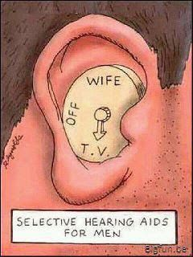

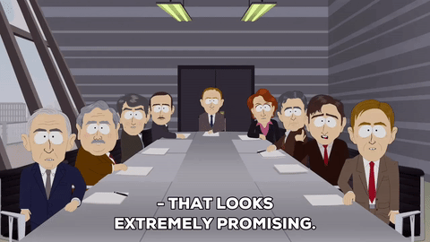
Speaker Separation: Potential Applications
Debate denoising - let one person speak at a time!
Automatic transcriptions with multiple speakers (such as in meetings).
Controlled hearing aids - enhances the speech of target speaker in noisy environments.
Blind speech separation.
(a)
(b)
(c)
Contact: {sindhu.hegde, aditya.ag, bipasha.sen, radrabha.m}@research.iiit.ac.in

Slide 4



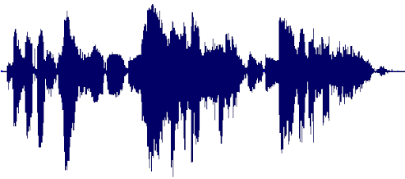
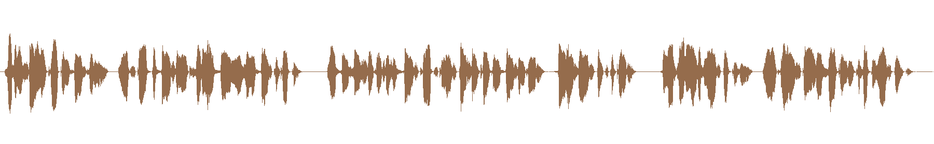
Audio-Visual Speaker Separation: Overview
… keep trying to fund raise ...
… I don’t feel strong ..
… keep trying to fund raise ...
Visual Features
Audio-Visual Network
Visual Stream Input
Audio Features
Mixed Speech Input
Isolated Target Speaker
Contact: {sindhu.hegde, aditya.ag, bipasha.sen, radrabha.m}@research.iiit.ac.in

Slide 5
Why do we need Visual Stream?
The task of separating the speech can be done using the audio modality alone.
Very hard to accomplish this using solely the audio modality.
Audio alone falls short is bringing all the information.
Permutation problem: No easy way to associate each separated audio source with its corresponding speaker in the video (example - play this particular speaker) Play the lady’s voice -
Visual stream along with the auditory input has proven to be extremely beneficial.
Visual stream allows us to “focus” the audio on the desired target speakers.
It also improves the overall speaker separation performance.
Contact: {sindhu.hegde, aditya.ag, bipasha.sen, radrabha.m}@research.iiit.ac.in

Slide 6
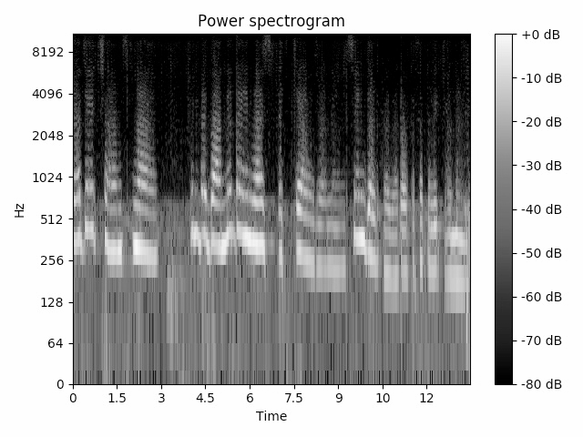
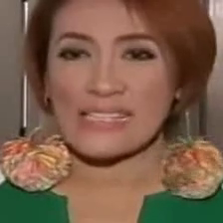
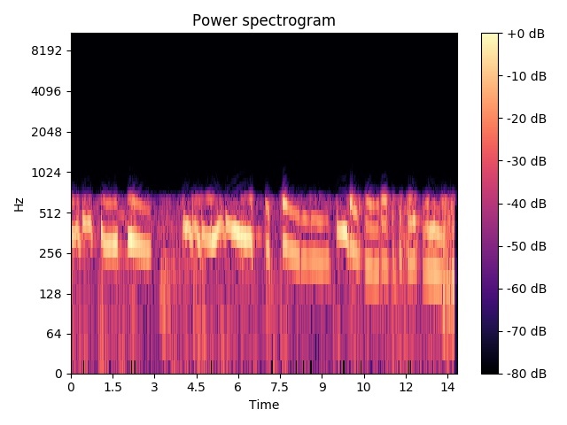
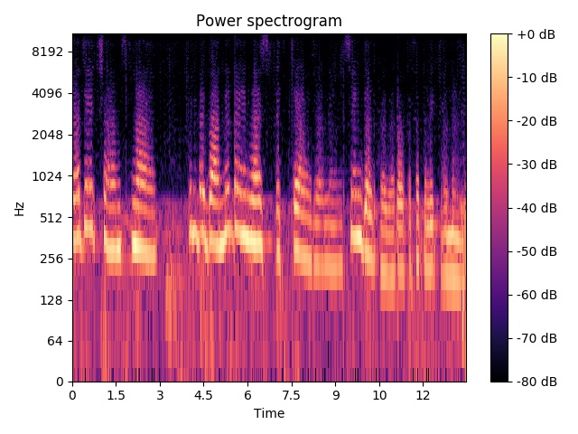

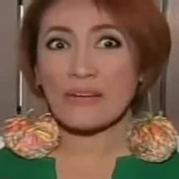
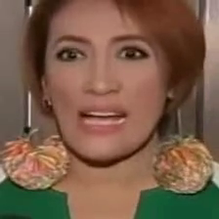
Audio-Visual Network: Architecture Overview
Encoder
Decoder
Concatenation
Tx1112
Speech Decoder
(1D Conv Block)
Tx512
Tx600
Tx514
4x upsample
Visual Encoder
(3D Conv Block)
Speech Encoder
(1D Conv Block)
(T/4)x512x1x1
Tx600
Residual mask
(Tx514)
Tx514
Tx514
+
STFT
ISTFT
(T/4)x3x96x96
Contact: {sindhu.hegde, aditya.ag, bipasha.sen, radrabha.m}@research.iiit.ac.in

Slide 7
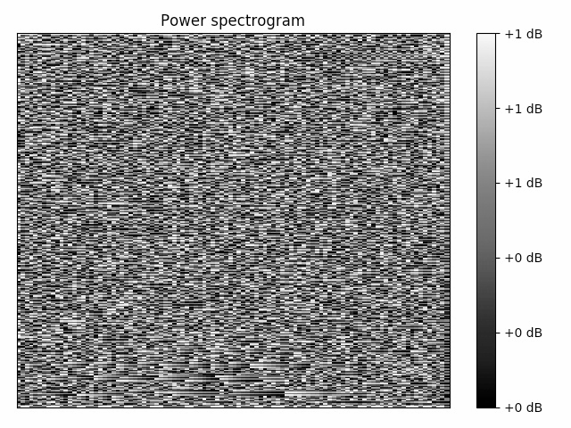
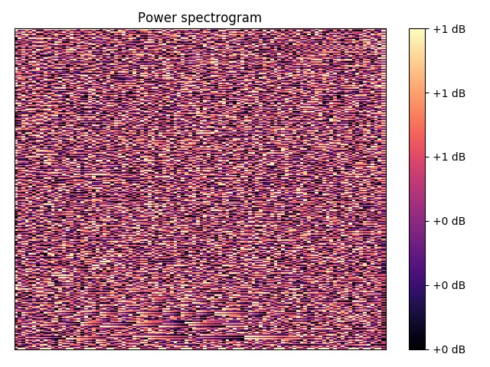
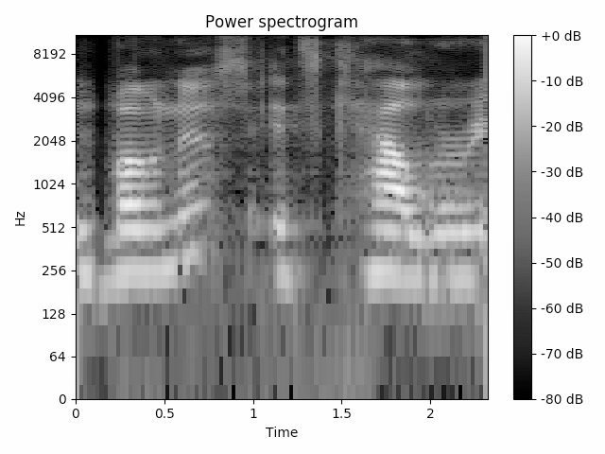
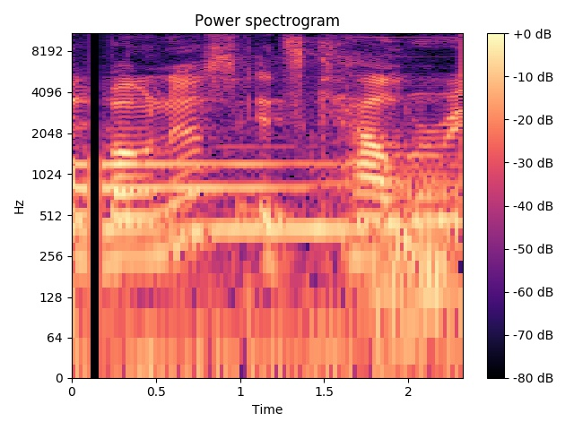
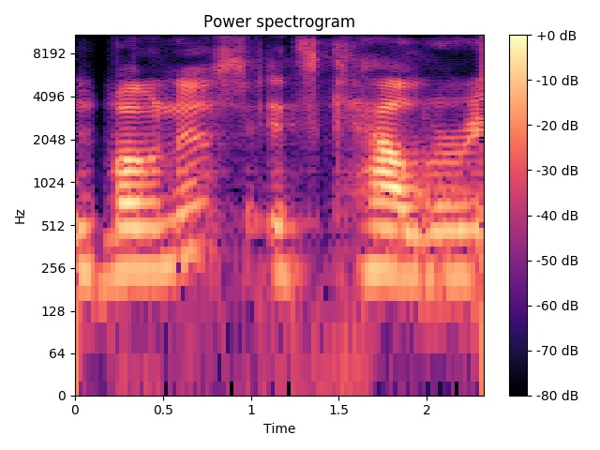
Audio-Visual Network: Detailed Architecture
Magnitude Sub-network
Phase Sub-network
Mag decoder
Phase
mask
+
Pred phase
Mag
mask
Visual encoder
Mag encoder
Phase network
Mixed mag
+
ISTFT
Pred mag
Mixed phase
Visual input
STFT
Target speech
Mixed speech
Contact: {sindhu.hegde, aditya.ag, bipasha.sen, radrabha.m}@research.iiit.ac.in

Slide 8
Audio-Visual Network: Representations
Audio-Visual network: Takes both the visual stream and the mixed auditory stream as the input and generates the isolated speech for the target speaker.
Audio representation:
Extract linear spectrogram using short-time Fourier transform (STFT) from 1-second segment of mixed speech input.
Decompose the complex time-frequency representation (T x 257) into magnitude and the phase components, and normalize them between [0, 1].
The mag and the phase components, each of dimension (T x 257) act as input to the respective magnitude and phase encoder networks.
Visual representation:
The corresponding visual 1-second of frames are extracted (25 frames).
The resized frames (96x96x3) act as input to the visual encoder.
Contact: {sindhu.hegde, aditya.ag, bipasha.sen, radrabha.m}@research.iiit.ac.in

Slide 9
Audio-Visual Network: Training details
Magnitude Sub-network:
Visual Encoder:
Processes the input images using a stack of residual 2D-convolution blocks and generates a visual embedding for each frame (T’x512) where T’=25 frames.
The output of the visual encoder module is up-sampled 4× to match the spectrogram temporal dimension (Tx512) where T=100.
Mag Encoder:
Processes the input mixed mag representation (T x 257) using a stack of 1D-convolution blocks with residual connections.
Convolutions are performed along the temporal dimension, by considering the frequency component of the input spectrograms as channels (Tx600).
Mag Decoder:
Concatenate the learned features of each stream along the channels (Tx1112).
Processes the fused representation using a stack of residual 1D-convolution blocks.
Output: A magnitude mask (Tx257) that is added to input magnitude followed by a sigmoid activation to generate the enhanced magnitude spectrogram output (Tx257).
Contact: {sindhu.hegde, aditya.ag, bipasha.sen, radrabha.m}@research.iiit.ac.in

Slide 10
Audio-Visual Network: Training details
Phase Sub-network:
Concatenate the predicted magnitude (Tx257), visual embeddings (Tx512) and the input mixed phase (Tx257) representations along the channels (Tx1026).
The phase network processed the fused representation using a stack of residual 1D convolution layers.
Output: A residual phase mask (Tx257) that is added to the input phase followed by a sigmoid activation to generate the enhanced phase spectrogram output (Tx257).
The enhanced speech output is obtained by computing the inverse-STFT (ISTFT) from the magnitude and phase predictions.
Losses:
Magnitude prediction: L1 loss
Phase prediction: Cosine similarity
Total loss = Mag loss + Phase loss
Contact: {sindhu.hegde, aditya.ag, bipasha.sen, radrabha.m}@research.iiit.ac.in

Slide 11










Dataset and Experimental setup
VoxCeleb2 dataset:
A large-scale talking-face video dataset containing
celebrity videos.
Contains over 1 million utterances for 6,112 celebrities.
A challenging dataset that spans a wide variety of
identities, languages, and face poses.
Fig.: Dataset samples.
Table.: Statistics of the VoxCeleb2 dataset.
 | Train | Test
# speakers | 5,994 | 118
# videos | 145,569 | 4,911
Contact: {sindhu.hegde, aditya.ag, bipasha.sen, radrabha.m}@research.iiit.ac.in

Slide 12


Qualitative Results
Contact: {sindhu.hegde, aditya.ag, bipasha.sen, radrabha.m}@research.iiit.ac.in

Slide 13
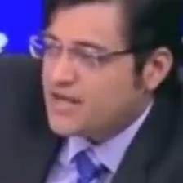

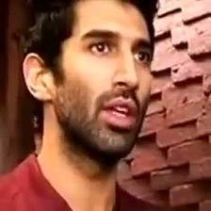
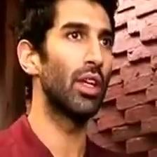
Qualitative Results
Contact: {sindhu.hegde, aditya.ag, bipasha.sen, radrabha.m}@research.iiit.ac.in

Slide 14




Qualitative Results
Contact: {sindhu.hegde, aditya.ag, bipasha.sen, radrabha.m}@research.iiit.ac.in

Slide 15

Q&A Break
Time for interaction
Contact: {sindhu.hegde, aditya.ag, bipasha.sen, radrabha.m}@research.iiit.ac.in

Slide 16
Time for Code Walk-through!
Repository: https://github.com/Sindhu-Hegde/speaker-separation
Clone and star the repo 😄
The repo has the complete train and test codes along with the pre-trained model for the task of speaker separation.
A demo inference file (collab notebook) is also provided.
Related works:
The Conversation: Deep Audio-Visual Speech Enhancement.Triantafyllos Afouras, Joon Son Chung, and Andrew Zisserman, In Interspeech 2018.
Looking to Listen at the Cocktail Party: A Speaker-Independent Audio-Visual Model for Speech Separation. Ephrat, A., Inbar Mosseri, Oran Lang, Tali Dekel, K. Wilson, Avinatan Hassidim, W. Freeman and Michael Rubinstein, In ACM Transactions on Graphics (ToG) 2018.
Contact: {sindhu.hegde, aditya.ag, bipasha.sen, radrabha.m}@research.iiit.ac.in

